Slide 1


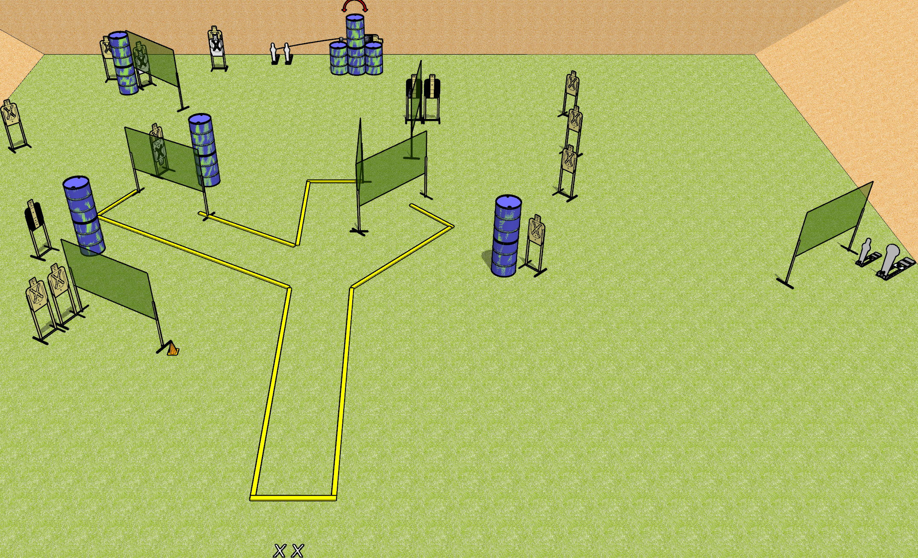
 | Dothan Gun Club – USPSA Match Just Plain Mean Course Designer : Drew Coleman
START POSITION : Standing with both feet on X’s, wrists below belt
GUN READY CONDITION : Pistol loaded and holstered. PCC loaded, shouldered, safety on, pointed at orange cone. |  | SCORING: Comstock, 34 rounds TARGETS: 15 paper, 4 Steel SCORED HITS: Best 2 on paper, steel until down START-STOP: Audible, last shot RULES:
STAGE PROCEDURE: Engage targets as they become available from within the fault lines.

Slide 2
Just Plain Mean
Written Stage Briefing
Just Plain Mean is a 34 round, 170 point, Comstock field course. There are fifteen USPSA targets, one Colt popper, and three mini poppers. The best two hits on paper will score. Steel must fall to score. The start signal is audible.
The swinger is activated by either of the mini poppers located nearby. Please check the activator before the first shooter and set it up the same way every time.
Handgun start position is standing with both feet on X’s, wrists below belt. Handgun is loaded and holstered.
PCC start position is standing with both feet on X’s, muzzle pointed at orange cone. Loaded carbine is held with both hands, safety on.
On start signal, engage targets as they become available from within the shooting area.

